Slide 1
NVIDIA ISAAC SIM · HANDS-ON TUTORIAL
Getting Started with
Isaac Sim
A step-by-step guide for complete beginners
Build, simulate, and deploy robots in NVIDIA Omniverse
Source: NVIDIA Official Documentation · docs.nvidia.com/learning/physical-ai/getting-started-with-isaac-sim
Notes:
Welcome to this hands-on Isaac Sim tutorial. By the end of this deck, you will have built a robot from scratch, imported a real robot (Carter), generated synthetic data, and deployed to Jetson. No prior Isaac Sim experience required. Follow every click and command exactly as shown.

Slide 2
LEARNING PATH
What you will build across 5 modules
MODULE 1
MODULE 2
MODULE 3
MODULE 4
Build Your First Robot
From a cube to a drivable robot with wheels, sensors, and keyboard control
Ingest Robot Assets
Import a URDF (Carter), add sensors, bridge to ROS 2
Synthetic Data
Generate labeled datasets with Replicator for perception training
Software-in-the-Loop
Drive robots with OmniGraph and Python; image segmentation
MODULE 5
Hardware-in-the-Loop — Deploy to NVIDIA Jetson, run Isaac ROS, test real-robot communication
Before you start: You need an NVIDIA GPU (RTX 2070 or better), Ubuntu 22.04, and about 2 hours. We begin with installation and UI basics, then build everything step by step.
Notes:
This deck follows the official NVIDIA learning path. Each module builds on the previous one. We start from zero — no Isaac Sim experience needed. Module 1 is the most hands-on: you will literally create a robot cube by cube.

Slide 3
PREREQUISITES
Before you begin: system requirements
Hardware
Software
NVIDIA RTX GPU: RTX 2070 (8GB) minimum, RTX 3090 / 4090 recommended
RAM: 32 GB minimum (64 GB recommended)
Storage: 30 GB free SSD
Monitor: 1920x1080 or higher
Ubuntu 22.04 LTS (Isaac Sim does not support Windows natively)
NVIDIA GPU driver version 550+
Python 3.10 (bundled with Isaac Sim)
ROS 2 Humble or Jazzy (for Modules 2-5)
No Linux machine? You can run Isaac Sim on a cloud GPU instance (AWS G5, Lambda Labs) and connect remotely via WebRTC — covered in the appendix of this deck.
Notes:
Isaac Sim is built on Omniverse, which requires NVIDIA RTX hardware for ray tracing. If you only have an older GPU, you can still run it but performance will be poor. The cloud + WebRTC path is a great alternative.

Slide 4
STEP 0 · INSTALLATION
Download and launch Isaac Sim
1. Download from NVIDIA
Go to developer.nvidia.com/isaac-sim, download the Isaac Sim 4.x package for Ubuntu 22.04. Extract the archive anywhere, e.g. ~/isaac_sim.
2. First launch (command line)
cd ~/isaac_sim
./isaac-sim.sh
3. What you see on first launch
A USD Explorer window opens with an empty stage — this is the 3D viewport.
Left panel: Stage (scene hierarchy). Right panel: Property (selected object details).
Bottom: timeline with Play/Pause/Stop controls. Top menu: Create, Window, Workflows.
Notes:
First launch takes 2-5 minutes while it shaders compile. If you see a blank viewport, that is normal — we will add objects in Module 1. The ./isaac-sim.sh script launches the full GUI. For headless or remote modes, see the WebRTC appendix.

Slide 5
STEP 0 · ALTERNATIVE LAUNCH
Run Isaac Sim remotely via WebRTC streaming
If your laptop lacks a GPU: run Isaac Sim on a remote GPU server and connect with the NVIDIA Streaming Client app.
Step 1: SSH into the server with PuTTY
Step 2: Start Isaac Sim streaming
Open PuTTY, enter the server IP and port 22
Log in with your username and password
You now have a terminal on the GPU server
cd ~/isaac_sim
./isaac-sim.streaming.sh \
--/app/livestream/publicEndpointAddress=<SERVER_IP> \
--/app/livestream/port=49100
Step 3: Connect with the NVIDIA Streaming Client app
Download the Streaming Client from NVIDIA (docs.isaacsim.omniverse.nvidia.com > Installation > Download). Install on your Windows laptop. Open it, enter the server IP in the Server field, and click Connect. The Isaac Sim viewport appears in a window.
Tips:
- Use nohup or tmux so Isaac Sim keeps running if PuTTY disconnects: nohup ./isaac-sim.streaming.sh ... &
- This is NVIDIA's recommended remote method. X11 forwarding and Windows RDP do NOT work well with Isaac Sim (slow or crashes due to GPU conflicts).
Notes:
The workflow is: PuTTY SSH into the GPU server, launch the streaming script in that terminal, then use the NVIDIA Streaming Client desktop app on your laptop to connect. Do NOT use a browser or RDP — NVIDIA's own streaming client is the only reliable remote method.

Slide 6
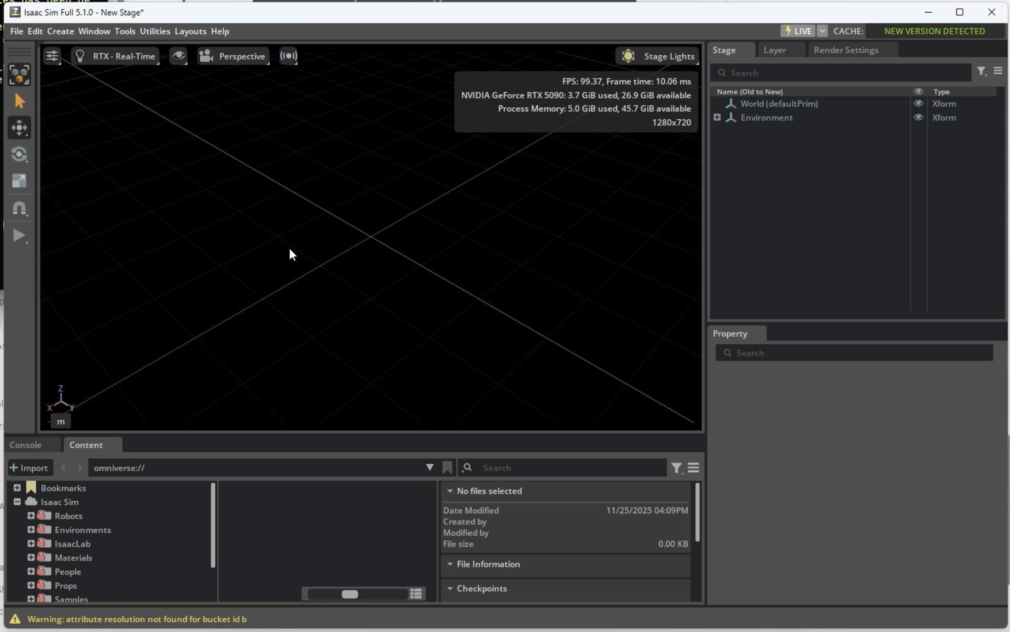
GETTING STARTED · UI TOUR
The Isaac Sim main window: know your workspace
1. Menu Bar
File / Edit / Create / Window / Help. Open, save, add prims, manage extensions.
2. Toolbar
Play/Stop simulation, Move (W) / Rotate (E) / Scale (R) gizmo modes, camera controls.
3. Viewport (3D scene)
The 3D view. Left-drag orbit, right-drag pan, scroll wheel zoom. This is where your robot appears.
4. Stage (Outliner)
Hierarchy of every object in the scene. Click an item to select it and edit it below.
5. Property Panel
Edit selected object: Transform (position/rotation), RigidBody, Collision, physics materials.
6. Content Browser — drag robots, props, USD assets into the scene. Bottom tabs switch to Console for logs.
Notes:
This is the default Isaac Sim dark theme. The Stage panel on the right-top lists scene objects; Property panel below edits the selected object; center viewport is where you navigate in 3D; bottom Content Browser is where you drag in new assets. Panels can be rearranged by dragging their tabs.

Slide 7
STEP 0 · UI NAVIGATION
Mouse and viewport controls
Camera navigation in the viewport
Key panels you will use
Left-click + drag — orbit around the selected point
Right-click + drag — pan the camera
Mouse wheel — zoom in / out
Ctrl + left-click — select an object
F key — focus camera on selected object
Stage (left) — every object in the scene, as a tree
Property (right) — edit position, physics, joints
Create menu (top) — add cubes, lights, physics
Play / Pause (bottom) — start/stop physics simulation
Try it now: Press Create > Light > Distant Light to add lighting. Then press F to focus. You should see a lit default stage.
Notes:
Spend 2 minutes practicing camera controls. This is the most basic skill. Orbit by left-dragging, pan by right-dragging, zoom with the wheel. The Stage panel is where we will see every object we create.

Slide 8
MODULE 1 · BUILDING YOUR FIRST ROBOT
From a cube to a
drivable robot
We will create a rear-wheel-drive differential robot from scratch:
a chassis cube, four wheels, four revolute joints, physics, and WASD keyboard control.
Notes:
This is the most hands-on module. Every click matters. Follow each step exactly. At the end, you will press Play and your robot will roll on its own.

Slide 9
MODULE 1 · STEP 1
Create the chassis: cube + parent Xform
Step A: Create the cube chassis
Step B: Create parent Xform container
Create > Mesh > Cube — appears at origin (0,0,0)
In Property > Transform, set Scale = (2, 1, 0.5)
Keep Translation at (0, 0, 0) — do NOT lift it high
Press F to frame the view
Right-click in Stage > Create > Xform
Rename it to SimpleRobot
Drag the Cube onto SimpleRobot in Stage tree
Select SimpleRobot, set its Translation Z = 1 (lifts whole robot 1m off ground)
Why an Xform? It is an empty parent node. Moving it moves ALL children (chassis + future wheels) together. This way you position the whole robot at once, instead of moving each part separately.
Expected result in Stage tree:
World
└── SimpleRobot (Translation Z = 1)
└── Cube (Scale = 2, 1, 0.5) ← this is the chassis
Notes:
The chassis cube stays at origin inside the SimpleRobot Xform. The Xform lifts the whole robot 1 meter up. Scale is 2x1x0.5 meters. Do NOT set the cube itself to Z=50 — that was wrong.

Slide 10
MODULE 1 · STEP 2
Enable physics: Physics Scene + Rigid Body
Step 1: Add Physics Scene (global)
Why "Rigid Body with Colliders Preset"?
It does two things at once: (1) marks the cube as a dynamic physics object that falls, and (2) creates an invisible collision mesh shaped like the cube.
Without colliders, objects pass through each other. You should now see a green wireframe around the cube if you enable Show > By Type > Physics > Colliders.
Create > Physics > Physics Scene — turns on the physics engine for the whole stage. One per scene.
Step 2: Add Rigid Body to the cube
Right-click the cube in the Stage panel
Select Add > Physics > Rigid Body with Colliders Preset
This adds both Rigid Body AND a collision mesh automatically
Note: Press Play now — the cube falls forever because there is no ground yet. (In the official tutorial the cube is still the default 1x1x1; you scale it to 2,1,0.5 and add the SimpleRobot xform after the gravity test passes.) We add the ground on the next slide.
Notes:
The tutorial uses "Rigid Body with Colliders Preset" (right-click menu), not the Create menu. This preset adds both a physics rigid body and a collision mesh. The cube currently has no ground to rest on.

Slide 11
MODULE 1 · STEP 3
Add ground plane and test gravity
Step 1: Add the floor
If the cube falls through the floor:
Physics Scene exists in Stage?
Cube has Rigid Body with Colliders Preset?
If nothing happens: press Play (triangle). Physics only runs while the timeline is playing.
Next step: Stop, then scale the cube to (2, 1, 0.5) and create the SimpleRobot parent xform that lifts the whole robot.
Create > Physics > Ground Plane — an infinite static floor.
Step 2: Raise the cube above the ground
Move the cube up to Z = 1 (1 meter; default unit is meters, Z is up). In the full robot this is done by raising the parent SimpleRobot xform, not the cube itself.
Step 3: Press Play
The cube drops from Z=1 and lands on the ground plane. Click Stop when it settles.
What you just verified: gravity works, collision works, ground plane catches objects. Save your work (File > Save) before moving on.
Notes:
The cube starts at Z=1 (1 meter above ground), not Z=50. Press Play, watch it fall 1 meter and land. This confirms physics is set up correctly before building the full robot.

Slide 12
MODULE 1 · ADDING THE FOUR WHEELS
Create and position the wheels
Create the first wheel (as a child of SimpleRobot):
Why (0.5, 0.75, 0)?
Chassis scale is (2, 1, 0.5): half-length X=1, half-width Y=0.5.
X=0.5: wheel is halfway from center to front edge.
Y=0.75: wheel center is 0.25m outside the chassis side (half-width=0.5), so the wheel sticks out sideways.
Z=0: wheel sits at chassis center height.
Right-click SimpleRobot in Stage > Create > Mesh > Cylinder
In Transform: set Rotation X = 90 (lays cylinder on its side)
Set Scale = (0.75, 0.75, 0.25)
Set Translation = (0.5, 0.75, 0)
Rename to Front_Left_Wheel
Duplicate (Ctrl+D) and position all 4 wheels:
Front_Left_Wheel: Translation = ( 0.5, 0.75, 0)
Front_Right_Wheel: Translation = ( 0.5, -0.75, 0)
Rear_Left_Wheel: Translation = (-0.5, 0.75, 0)
Rear_Right_Wheel: Translation = (-0.5, -0.75, 0)
Then: select all 4 wheels > right-click > Add > Rigid Body with Collision Preset. Press Play — wheels fall to ground independently. Then press Stop and Save.
Notes:
Per NVIDIA tutorial: wheel translation is (0.5, 0.75, 0), not (0.75, 0.75, 0). All wheels must be children of SimpleRobot. After adding Rigid Body, press Play to confirm wheels fall independently — this proves they are separate rigid bodies before joints are added.

Slide 13
MODULE 1 · PREPARING THE JOINTS
Create Revolute Joints — follow every step exactly
Step 0: Observe which axis the wheel spins on
Why select Cube first?
This lets Isaac Sim auto-compute the joint's local position on both bodies. You do NOT need to manually type Local Position values — they are set automatically when you select both bodies in this order.
If wheels snap to center on Play: you likely selected in wrong order, or changed Local Position manually. Delete the joint and redo Step 1.
Click any wheel in Stage. Look at the colored axis arrows in viewport. The wheel must rotate around the Y axis (green).
Step 1: Select both bodies — ORDER MATTERS
Click Cube FIRST (becomes Body 0 / parent)
Hold Ctrl, click Front_Left_Wheel (becomes Body 1 / child)
Right-click > Create > Physics > Joint > Revolute Joint
Step 2: Fix the joint orientation in Property panel (defaults are wrong):
Axis: change from X to Y (default points up; Y = wheel spin axis)
Local Rotation 0: set to (0, 0, 0) (aligns joint with wheel orientation)
Local Rotation 1: set to (-90, 0, 0) (fixes blue Z arrow mismatch)
Step 3: Click away from the joint, then click it again to refresh the gizmo. Verify red X and blue Z arrows align with the wheel. Rename to Front_Left_Joint.
Step 4: Repeat Steps 0-3 for all 4 wheels. Then move the robot down to the ground plane (lower SimpleRobot Z back to 0, or use the viewport).
Step 5: Right-click the rear joint > Add > Physics > Angular Drive > set Damping = 10000, Target Velocity = 50. Repeat for the other rear joint. Press Play — robot moves forward.
Notes:
Strictly per NVIDIA tutorial: only Axis=Y, Local Rotation 0=(0,0,0), Local Rotation 1=(-90,0,0) are set manually. Local Position is auto-computed by selecting Cube first then Ctrl+wheel. Do NOT manually edit Local Position. If wheels snap to center, delete joint and recreate with correct selection order.

Slide 14
MODULE 1 · STEP 6
Add Articulation Root and press Play
Mark the SimpleRobot xform as Articulation Root (this is NOT a checkbox under Rigid Body — you must ADD it to the parent xform, not the cube)
In the Stage panel, right-click the SimpleRobot xform (the parent of chassis + wheels) — NOT the chassis cube
Select Add > Physics > Articulation Root
A "Physics Articulation Root" section appears in Property — done
This tells physics to treat chassis + 4 wheels as one connected mechanism
Why the xform and not the cube?
The Articulation Root must be the top of the robot hierarchy so the controller can find all joints under it. Official tutorial: right-click SimpleRobot > Add > Physics > Articulation Root. Then press Play.
The robot drops to the ground and stays there — wheels touching floor, chassis hovering. No falling apart.
If something goes wrong:
Wheels fall off / robot explodes: Articulation Root not added to SimpleRobot xform, or joints' Body 0 / Body 1 swapped
Robot sinks into floor: Wheel radius too small or SimpleRobot Z too low; wheels must touch ground
Robot slides forever: Add a Physics Material with friction, or increase the rear Angular Drive damping (10000)
Notes:
In Isaac Sim 5.x, Articulation Root is not a checkbox under Rigid Body. Select the chassis prim, then click + Add in the Property panel and choose Physics > Articulation Root. This tells the physics engine to treat chassis + wheels as one connected mechanism.

Slide 15
MODULE 1 · STEP 7
Make it drive: Differential Controller and teleop
Add a Differential Controller
What is a Differential Drive?
Two wheels on an axle. To go forward, both wheels spin forward. To turn, spin them at different speeds — left wheel slower = turn left.
The Differential Controller takes a linear velocity (forward speed) and angular velocity (turn rate), and automatically commands the correct left/right wheel speeds.
Differential Controller is basically not a low-level joint driver, but a robot kinematics controller. Its function is: based on the input linear velocity and angular velocity, calculate how fast each of the left and right wheels should spin, and then send the speed commands to the wheel joints through the Articulation Controller. It's not on the same level as Angular Drive.
Go to Tools > Robotics > OmniGraph Controllers > Differential Controller
Set Robot Prim = SimpleRobot; Wheel radius = 0.375; Distance between wheels = 1.5
Controllable joints: add rear_left_joint and rear_right_joint (the rear wheels drive the robot)
Set Use Keyboard Control = true, then press OK and Play
Drive it with keyboard
W/S = forward / backward
A/D = turn left / right
Press Play in Isaac Sim, then use WASD
Notes:
The Differential Controller is the brain that converts "go forward at 0.5 m/s, turn left" into left/right wheel commands. After adding it, press Play and use WASD. Your robot should move. This completes Module 1's core build.

Slide 16
MODULE 1 · SENSORS
Add a camera and lidar sensor
Camera sensor
Lidar sensor
Right-click SimpleRobot and choose Create > Xform; rename it to Front_Sensor and move it to the top-front of the chassis
Right-click Front_Sensor and choose Add > Rigid Body. Then select the Cube first, Ctrl+select Front_Sensor, and right-click Front_Sensor to choose Create > Physics > Joint > Fixed Joint
Select the new joint and confirm that Body 0 = Cube and Body 1 = Front_Sensor; if swapped, use the folder icon to reassign them
Add a small cube under Front_Sensor, set its Scale = (0.1, 0.1, 0.1), and rename it to Sensor_Mount; then choose Add > Rigid Body with Colliders Preset
Right-click Sensor_Mount and choose Create > Camera; set Rotation Y = -90 so it faces forward, and rename it to Robot_Camera; use the viewport camera dropdown to preview its POV
With Front_Sensor selected, choose Create > Isaac > Sensors > PhysXLidar > Rotating to add a 2D lidar
Move the lidar so it sits on top of the Sensor_Mount cube
In the Raw USD Properties panel, enable Draw Lines and Draw Points
Press Play; the debug lines rotate. Obstacles must have a Rigid Body with Colliders to be detected
Publish data via ROS 2 Bridge
Relaunch Isaac Sim after sourcing /opt/ros/humble/setup.bash; then go to Window > Extensions and enable the ROS 2 Bridge extension
Lidar Action Graph: wire together Isaac Read Lidar Beams, ROS 2 Publish Laser Scan, Isaac Read Simulation Time, and On Playback Tick
For the camera, use the ROS2 Camera Helper node to publish RGB images
In a terminal, run ros2 topic list and launch rviz2; set the Fixed Frame to the lidar frame and add a Laser Scan display
Notes:
Sensors make the robot perceive its world. The camera publishes RGB images, the lidar publishes 3D point clouds. Both go through the ROS 2 Bridge so you can see them in ROS 2 topics. This is the same pipeline real robots use.

Slide 17
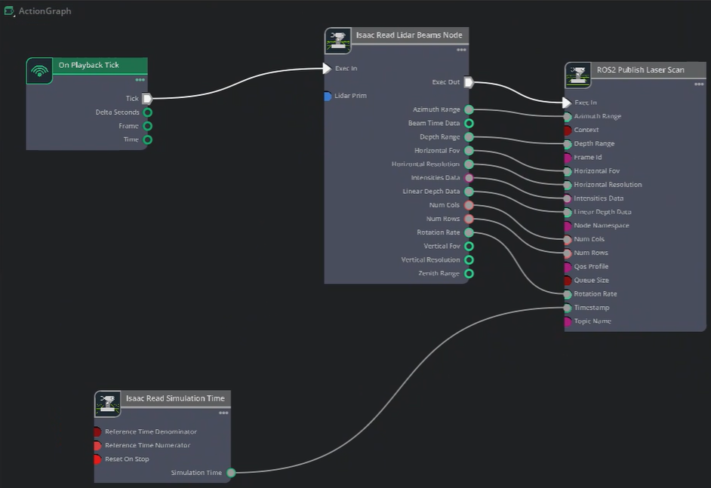
MODULE 1 · ACCESSING DATA
Stream sensor data to ROS 2 and RViz
1. Launch & enable ROS 2 Bridge
2. Lidar ActionGraph wiring (ROS2_LidarStream)
Terminal: source /opt/ros/humble/setup.bash
Launch: ./isaac-sim.sh (first time is slow)
Window > Extensions → search "ROS2" → enable ROS 2 Bridge
Create ActionGraph → rename ROS2_LidarStream
On Playback Tick
exec
Isaac Read Lidar Beams
Lasers
ROS 2 Publish Laser Scan
Timestamp
Isaac Read Simulation Time
3. Visualize in RViz
Press Play in Isaac Sim
Open a terminal with X11 forwarding, use:source /opt/ros/*/setup.bash to
establish environment
In the terminal: ros2 topic list → expect /scan_lidar
Start Xlaunch server in Windows, and in terminal Launch rviz2; set Fixed Frame = sim_lidar
In rviz2, Add > By Topic > Laser Scan; drive with WASD, watch red points
Notes:
Official NVIDIA tutorial section "Accessing Data". The lidar ActionGraph uses 4 nodes. TopicName=scan_lidar and FrameID=sim_lidar must match between Isaac Sim and RViz Fixed Frame. Camera RGB uses the ROS2 Camera Helper node.

Slide 18
MODULE 2 · INGESTING ROBOT ASSETS
Import a real robot:
NVIDIA Carter
Instead of building from cubes, we import a URDF model of the Carter robot,
add sensors, and bridge to ROS 2.
Notes:
Building from cubes is educational but slow. Real robots use URDF (Unified Robot Description Format). We will import NVIDIA's Carter robot — a real differential-drive research platform.

Slide 19
MODULE 2 · URDF IMPORT
Import Carter: step by step
What is URDF?
URDF is an XML file that describes a robot: its links (bodies) and joints (connections). ROS 2 uses URDF, so importing one means the same model works in simulation and on real hardware.
Import steps
Open Isaac Utils > File > Import > URDF
Browse to the Carter URDF file (included in the Isaac Sim assets folder: Isaac/Robots/Carter/carter_v1.urdf)
In import settings: check "Merge Fixed Links", set Default Primitive Resolution = 100000
Click Import — wait for the URDF to convert to USD (this takes 30-60 seconds)
Press F to frame the robot. You should see the Carter robot model
Add a Physics Scene and Ground Plane (same as Module 1), then press Play
Key tip: After import, the robot may be upside down or floating. Use Transform to rotate/translate it. The Carter URDF already includes wheel joints — no need to build them manually.
Notes:
The URDF importer converts the XML description into USD (Isaac Sim's native format). It creates links as meshes and joints as physics joints automatically. The Carter robot comes with a camera and lidar already modeled.

Slide 20
MODULE 3 · SYNTHETIC DATA GENERATION
Train your AI perception model
with synthetic data
Use NVIDIA Replicator to generate thousands of labeled training images automatically —
randomize lighting, textures, and object positions, then export with bounding box labels.
Notes:
Real-world AI training needs millions of labeled images. Synthetic data generation creates them in simulation: the camera renders the scene, and the labels come for free because the simulator knows exactly what is in the scene.

Slide 21
MODULE 3 · REPLICATOR
Run a Replicator script: generate labeled data
The big idea: Domain Randomization
Run the example script
Every frame, randomly change:
Lighting angle, color, and intensity
Object textures (materials)
Camera position and angle
Background and floor materials
The AI model learns to be robust to variation instead of memorizing one scene.
# Open Script Editor (Window > Script Editor)
# Load the Replicator example:
./python.sh standalone_examples/
api/usd_sensors.py
Output: a folder of PNG images + JSON annotation files with bounding boxes.
What you get
RGB images — rendered by the simulation camera
Bounding box labels — automatically generated, no human annotation needed
Segmentation masks — pixel-level class labels
Feed this dataset into YOLO, Detectron2, or any detection model for fine-tuning
Notes:
Replicator is NVIDIA's synthetic data toolkit. The key insight is that labels come for free: the simulator knows what every object is, so it can write the bounding box coordinates directly. Domain randomization ensures the model generalizes to real cameras.

Slide 22
MODULE 4 · SOFTWARE-IN-THE-LOOP
Drive robots with code:
OmniGraph and Python
Write Python scripts to control the robot, process camera images,
and run perception algorithms — all inside the simulation.
Notes:
SIL means your control software runs against the simulated robot, not the real one. This lets you test algorithms safely before deploying to hardware.

Slide 23
MODULE 4 · SCRIPTING
Control the robot with Python and OmniGraph
OmniGraph: visual node editor
Python Scripting
Open Window > Visual Scripting
Nodes = functions (Read Joint State, Apply Action, Camera Sample)
Connect nodes with wires to build a data flow graph
Good for: camera publishing, sensor reading, basic control loops
import omni.isaac.core as ic
robot = ic.robot.Leonard()
robot.apply_wheel_actions(
ic.utils.DiffDriveAction(0.5, 0.0))
Open Script Editor (Window > Script Editor) and write Python.
Image segmentation demo
Add a Camera to the robot, then use Create > Prediction > Bounding Box to draw detection boxes
Run the segmentation example: the camera view overlays colored masks for each object class
This is the same perception pipeline you would deploy on a real robot — tested here in simulation first
Notes:
OmniGraph is the visual node editor for simple data flows. Python scripting is for complex logic. Both run inside the simulation. The segmentation demo shows how AI perception works end-to-end: camera input > model inference > bounding box output.

Slide 24
MODULE 5 · HARDWARE-IN-THE-LOOP
Deploy to a real robot:
NVIDIA Jetson
Run Isaac ROS on a Jetson Orin/Nano, connect it to Isaac Sim,
and test your control stack with real hardware in the loop.
Notes:
HIL means the simulated robot talks to real hardware (or vice versa). The Jetson runs Isaac ROS, and the simulation acts as the robot's body. This lets you test ROS 2 nodes against a real compute board.

Slide 25
MODULE 5 · JETSON SETUP
Set up Jetson and deploy Isaac ROS
On the Jetson:
Connect to simulation
# Flash JetPack 6.x (Ubuntu 22.04)
# Install Isaac ROS:
sudo apt install isaac-ros-desktop
# Source ROS 2:
source /opt/ros/humble/setup.bash
On the PC running Isaac Sim, enable the ROS 2 Bridge
Make sure PC and Jetson are on the same network (same ROS_DOMAIN_ID)
On Jetson, run ros2 topic list — you should see topics from the sim
Publish velocity commands from Jetson, watch the sim robot move
HIL test workflow:
1. Start Isaac Sim on the PC with your robot scene loaded
2. On Jetson, run your ROS 2 navigation / perception nodes
3. Commands flow: Jetson → ROS 2 DDS → Isaac Sim → robot moves → sensor data returns → Jetson
4. Test the same code you will later run on the real robot — no risk of breaking hardware
Notes:
The key insight: ROS 2 DDS networking means the sim and the Jetson don't need a special connection — they just need to be on the same network and use the same ROS_DOMAIN_ID. Topics flow automatically.

Slide 26
YOU DID IT
What you accomplished
1. Built a drivable robot from a cube: chassis, wheels, joints, physics
2. Imported the NVIDIA Carter robot via URDF
3. Generated synthetic training data with Replicator
4. Wrote Python and OmniGraph control scripts
5. Set up Jetson and connected to simulation (HIL)
6. Learned to stream Isaac Sim remotely via WebRTC
Next: explore Isaac Lab, train RL agents, or deploy to a real robot. Full docs: docs.nvidia.com/isaac-sim
Notes:
Congratulations! You have completed the official NVIDIA Isaac Sim learning path. You built, imported, simulated, generated data, and deployed. The next step is to apply this to your own robot and research project.

